Slide 1
FedVoc-Person vs OSLO-Persoon
Compared by:
Liesbet D’hondt (BOSA)
Geert Thijs (Digitaal Vlaanderen)

Slide 2
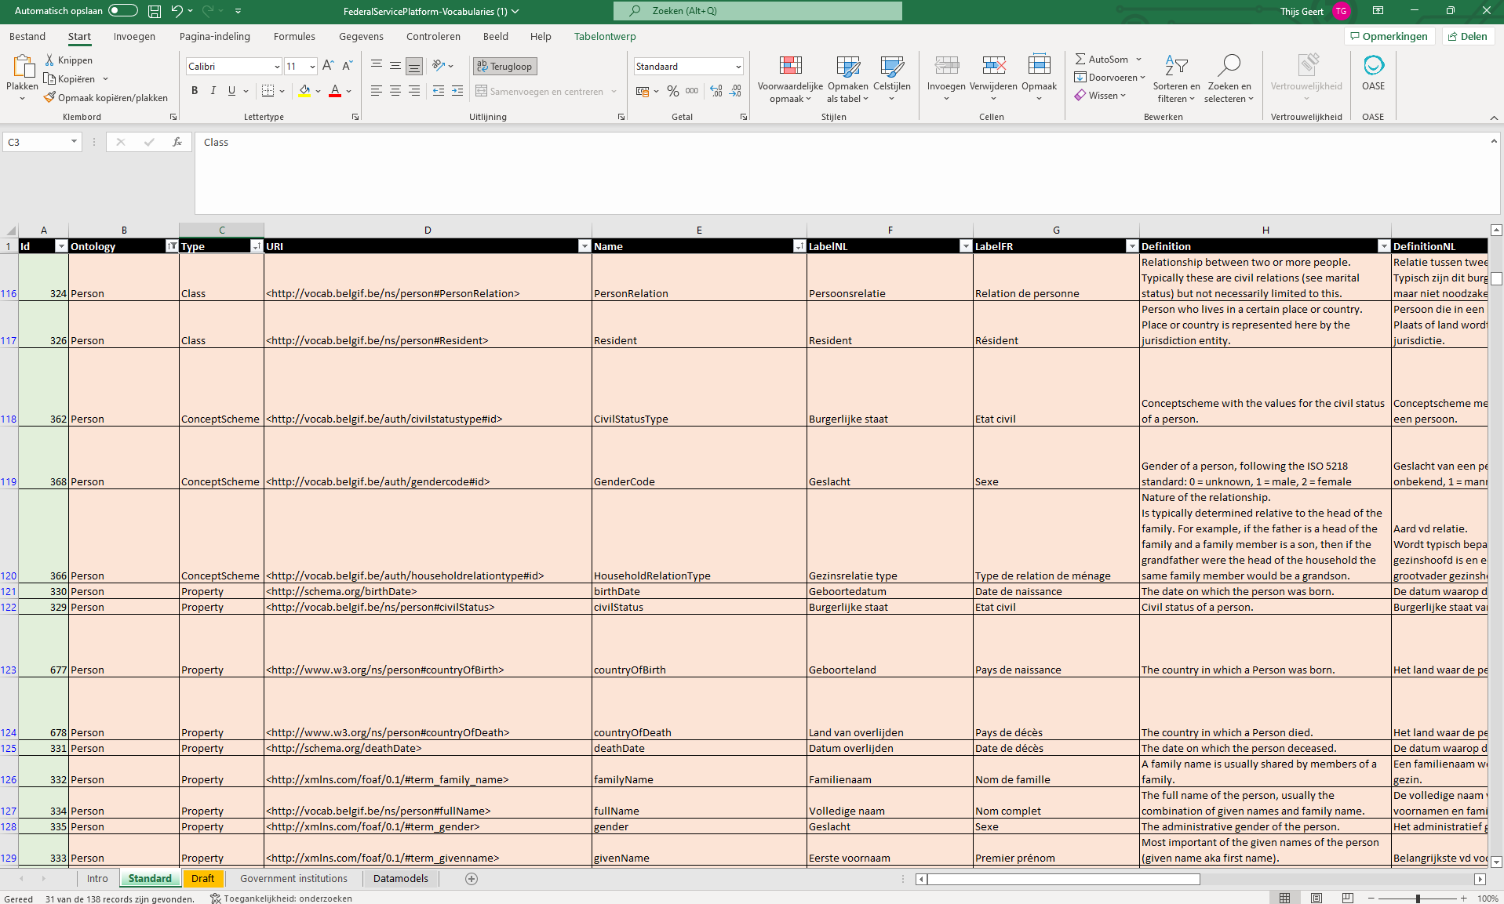
FedVoc-Person vs OSLO-Persoon: FedVoc-Person
Link

Slide 3
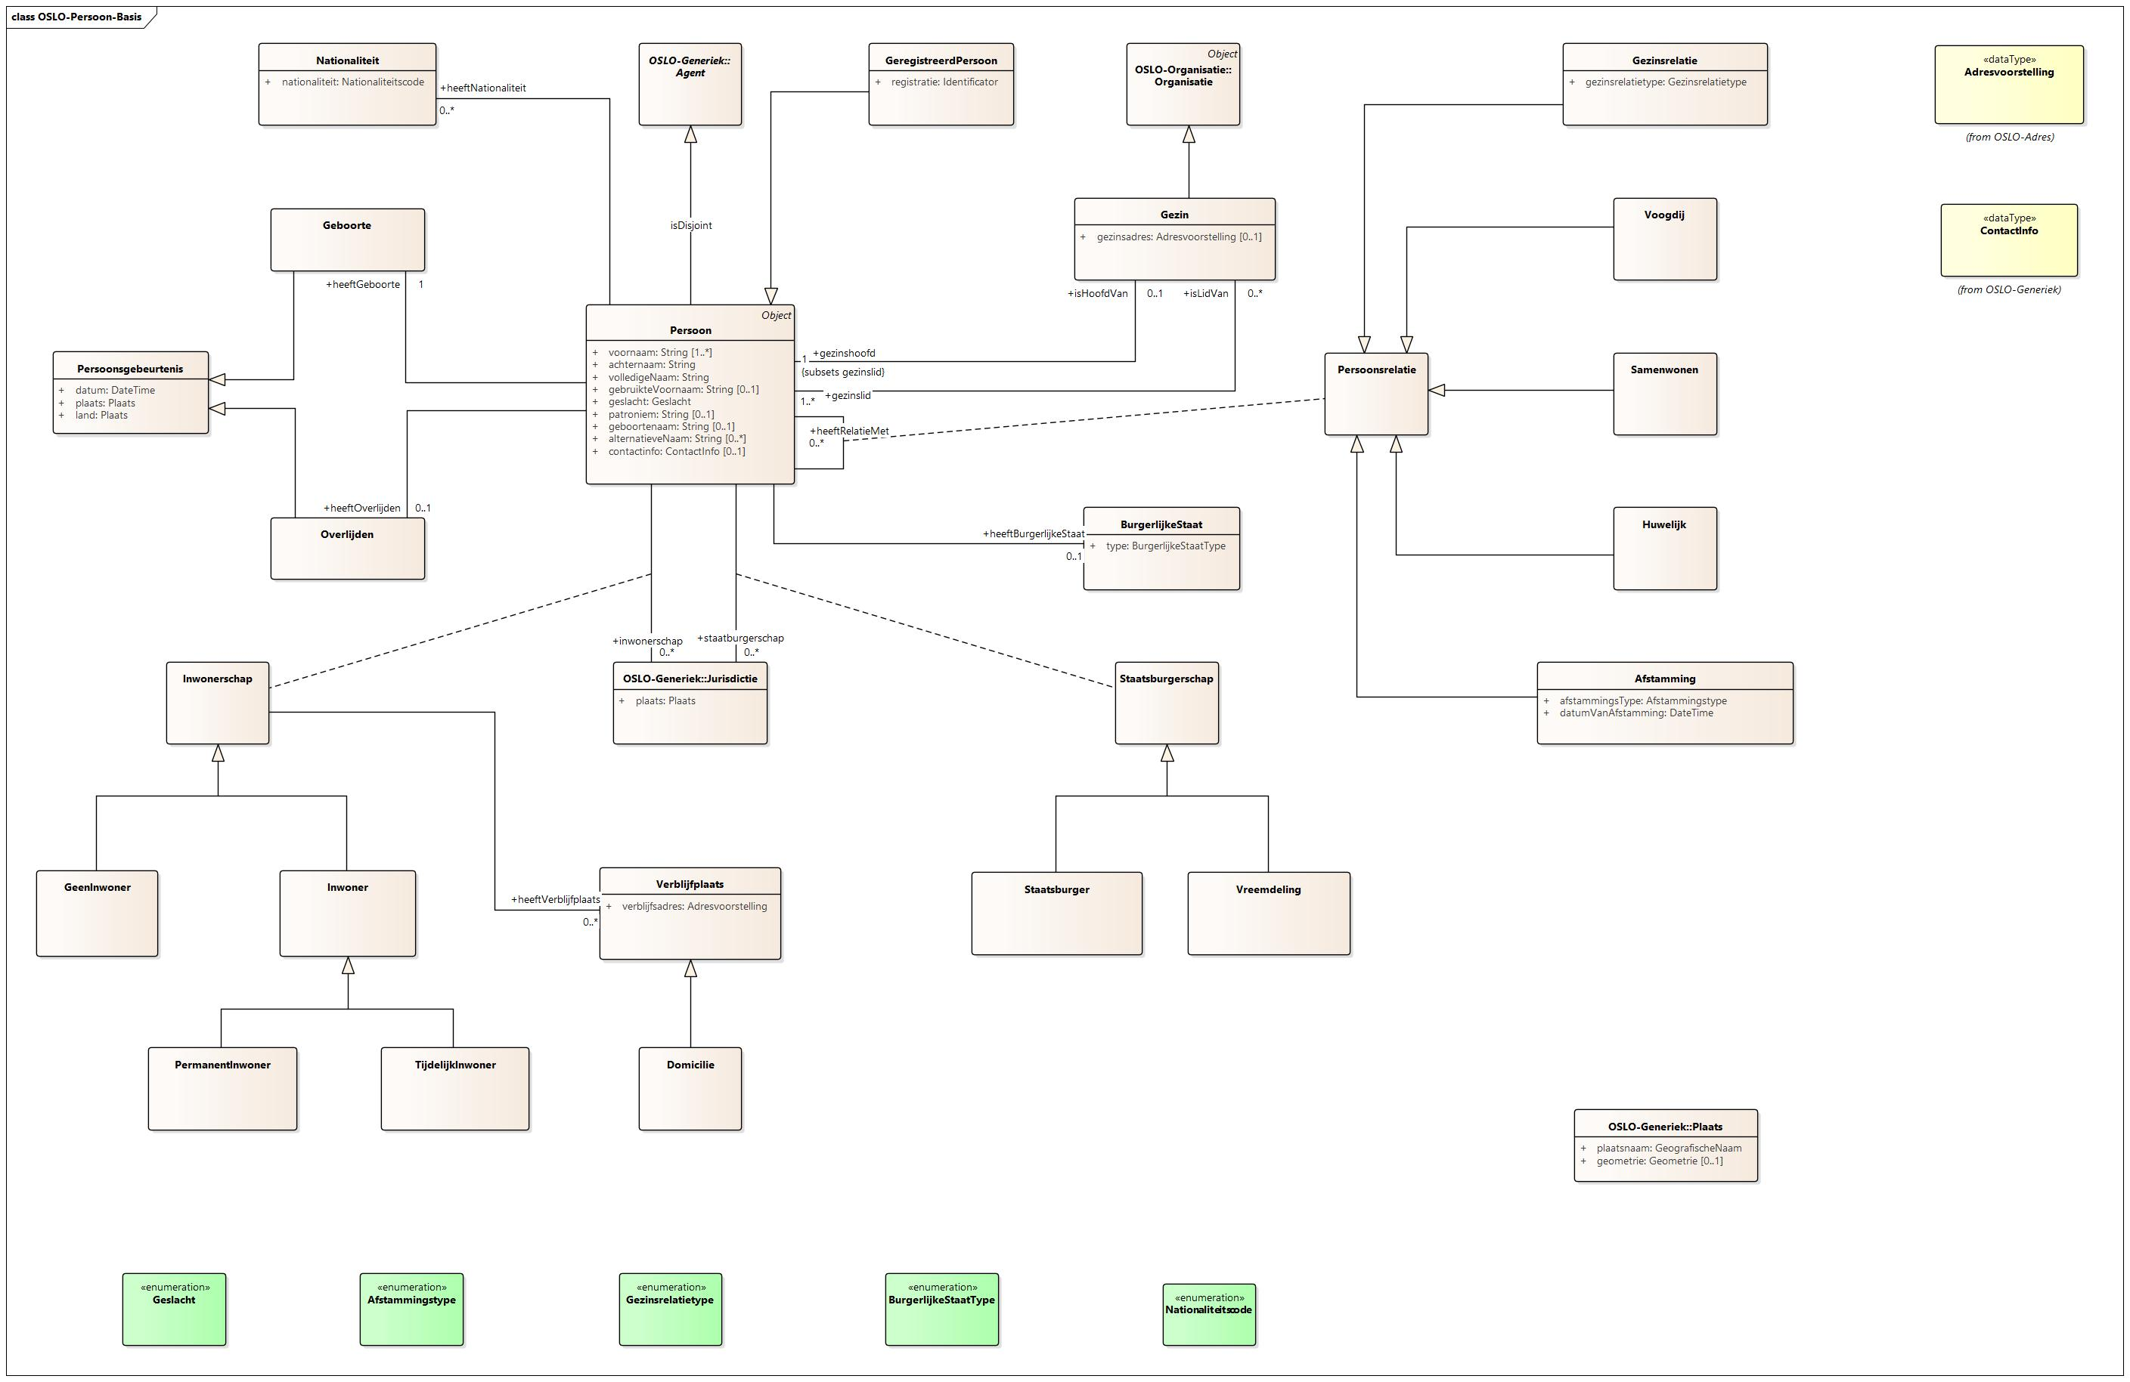
FedVoc-Person vs OSLO-Persoon: OSLO-Persoon
Link

Slide 4
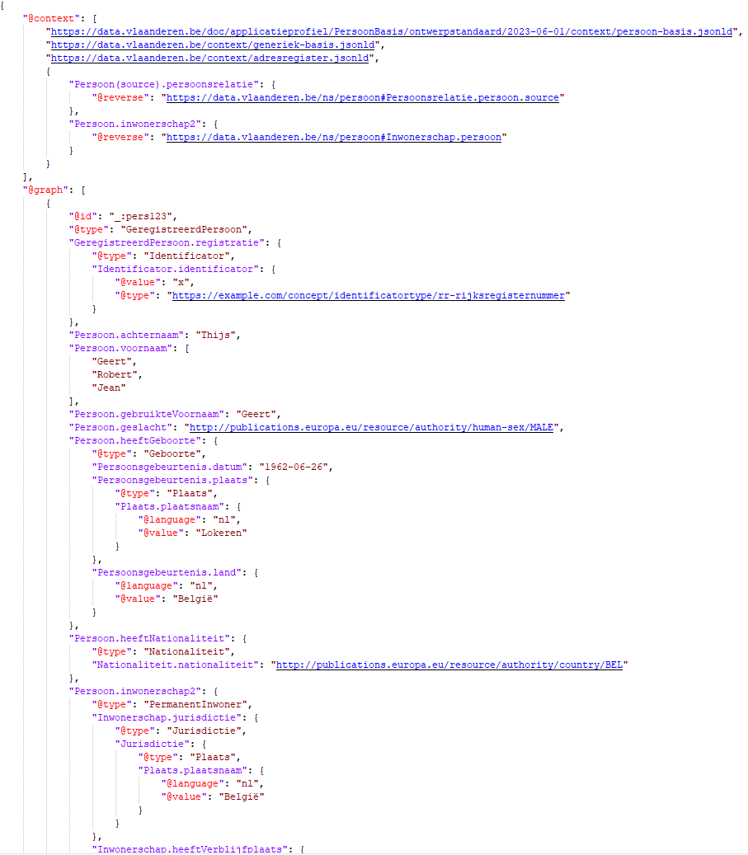
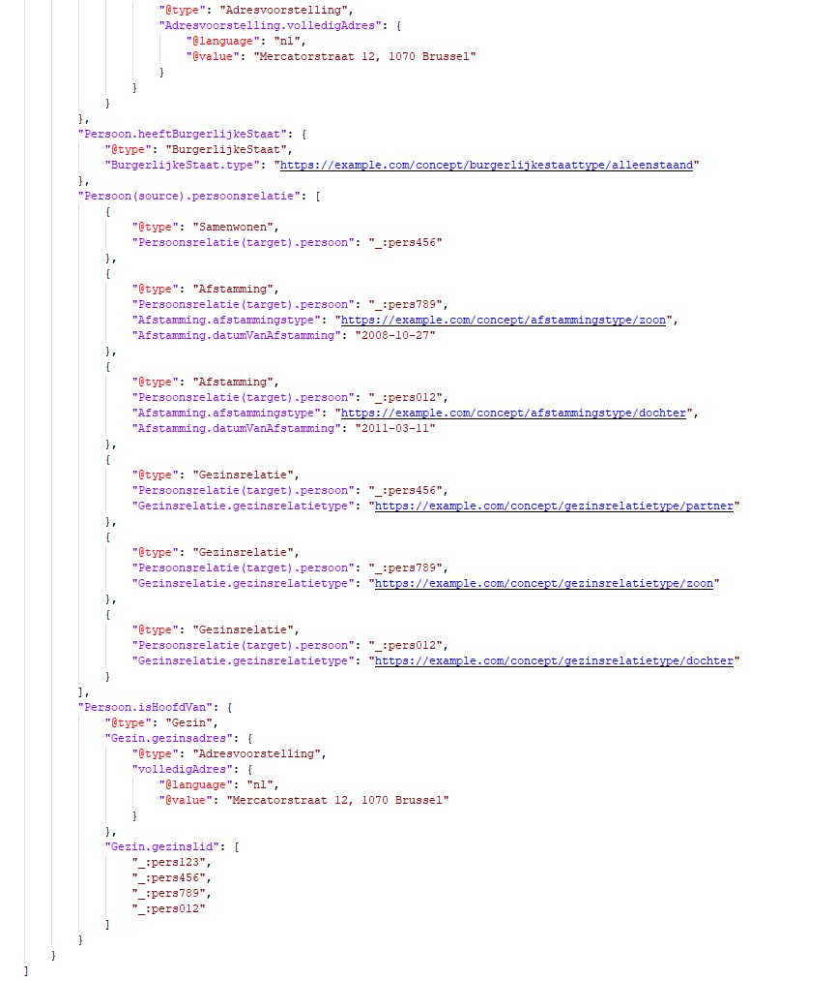
FedVoc-Person vs OSLO-Persoon: Data-example
Link

Slide 5
FedVoc-Person vs OSLO-Persoon
Comparison :
Concept
Model
Uri
Definitions
Specification

Slide 6
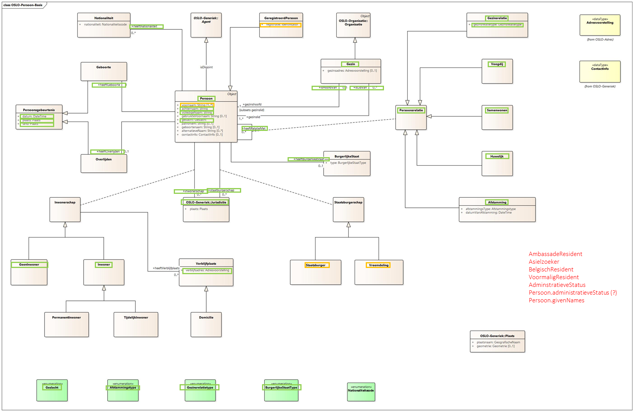
FedVoc-Person vs OSLO-Persoon: concept
identical
different
missing in OSLO

Slide 7
FedVoc-Person vs OSLO-Persoon: concept
Comment:
Identical: same concept
Different: other interpretation of same concept (eg givenName)
Missing in OSLO (eg AsylumSeeker)
In OSLO, not in ICEG (eg Domicile, Descent, Descent.descentType, Descent.descentDate, Household.householdAddress)

Slide 8
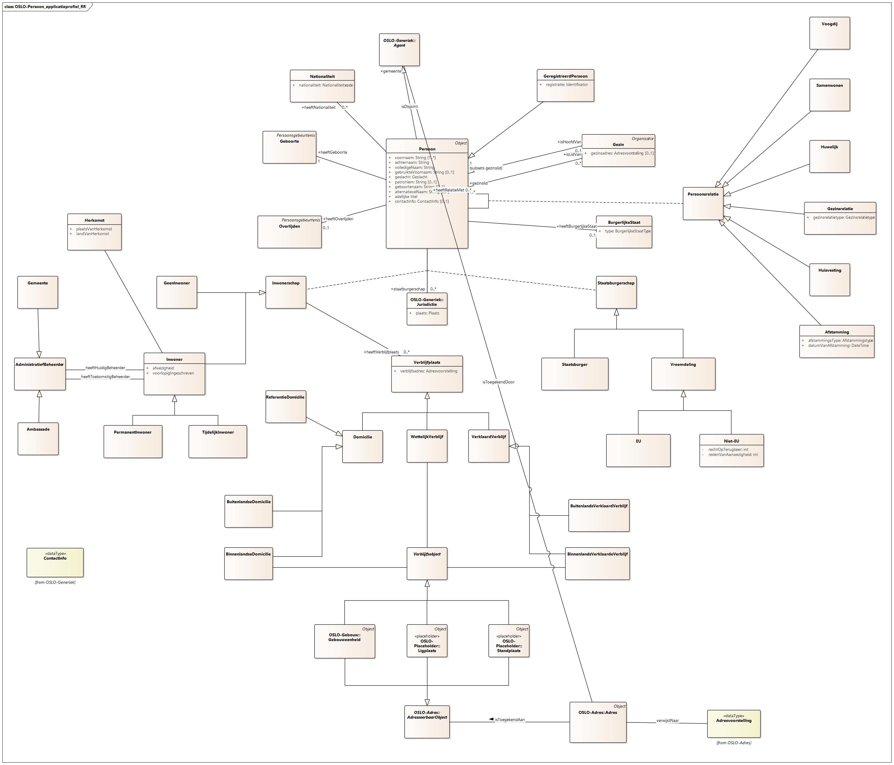
FedVoc-Person vs OSLO-Persoon: other NR concepts

Slide 9
FedVoc-Person vs OSLO-Persoon: model
Comment:
Model differences like:
Attribute in stead of association + Class (eg birthdate)
Two attributes in stead of Association Class with 2 attributes (eg person 1, person 2)
Specific attribute in stead of generic attribute (eg rrn)
Missing subclass-relations (eg between Personrelation and Marriage/HouseholdRelation etc)
Missing parenturi-relations (eg memberOf)
Relation with Concept instead of Class (eg civilStatus)
…

Slide 10
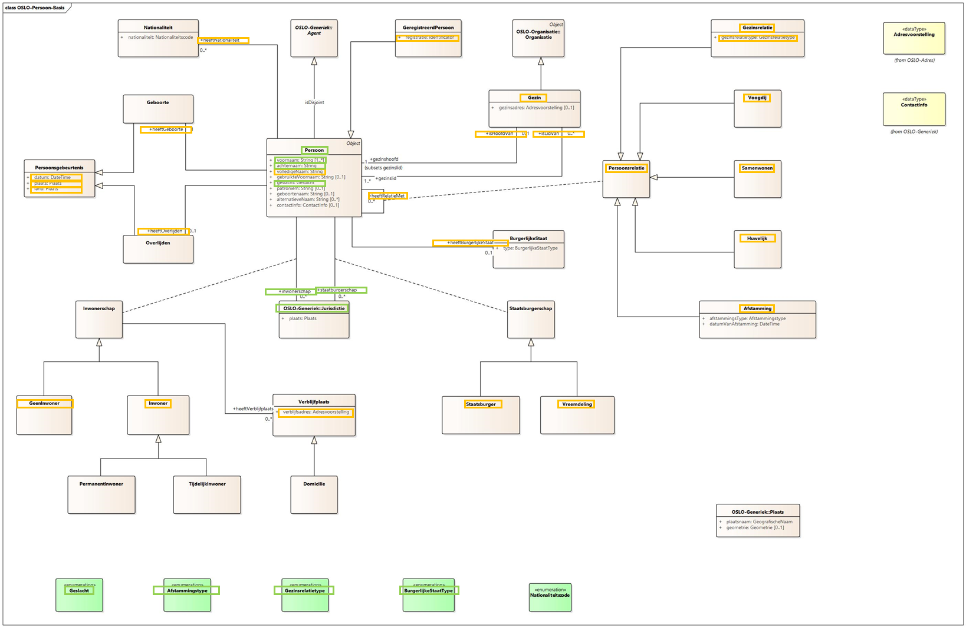
FedVoc-Person vs OSLO-Persoon: uri
identical uri
different uri

Slide 11
FedVoc-Person vs OSLO-Persoon: uri
Comment:
Identical uri: for external terms
Different uri: from data.vlaanderen to belgif.be

Slide 12
FedVoc-Person vs OSLO-Persoon: definitions
Comment:
TODO

Slide 13
FedVoc-Person vs OSLO-Persoon: specification
Comment:
FedVoc-Person: without toolchain?
OSLO-Persoon: with toolchain =>
UML diagram
Human-readable spec
RDF spec
JSON-LD contexfile
SHACL-file

Slide 14
FedVoc-Person vs OSLO-Persoon: conclusions
Plan:
Starting from UML-model OSLO-Persoon (with slight adaptations)
Add missing elements
Substitute data.vlaanderen uri’s with belgif uri’s
Configure translation
Use ICEG toolchain to produce a proper specification

Slide 15
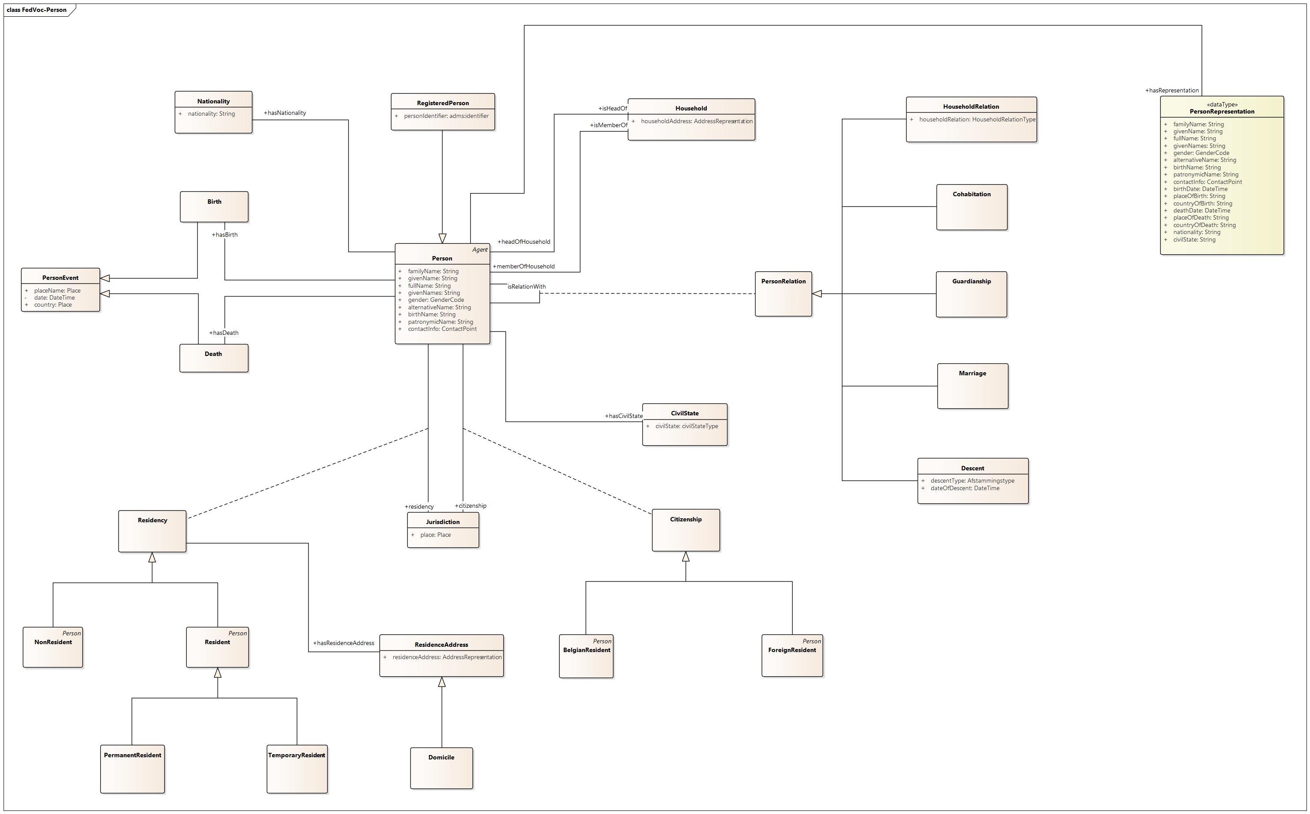
FedVoc-Person vs OSLO-Persoon: adapted model
To be added:
AsylumSeeker
EmbassyResident
AdminstrativeStatus?

Slide 16
FedVoc-Person vs OSLO-Persoon: adapted model
Changes:
Adding PersonRepresentation.
Subclasses of Residency and Citizenship also inherit from Person

Slide 17
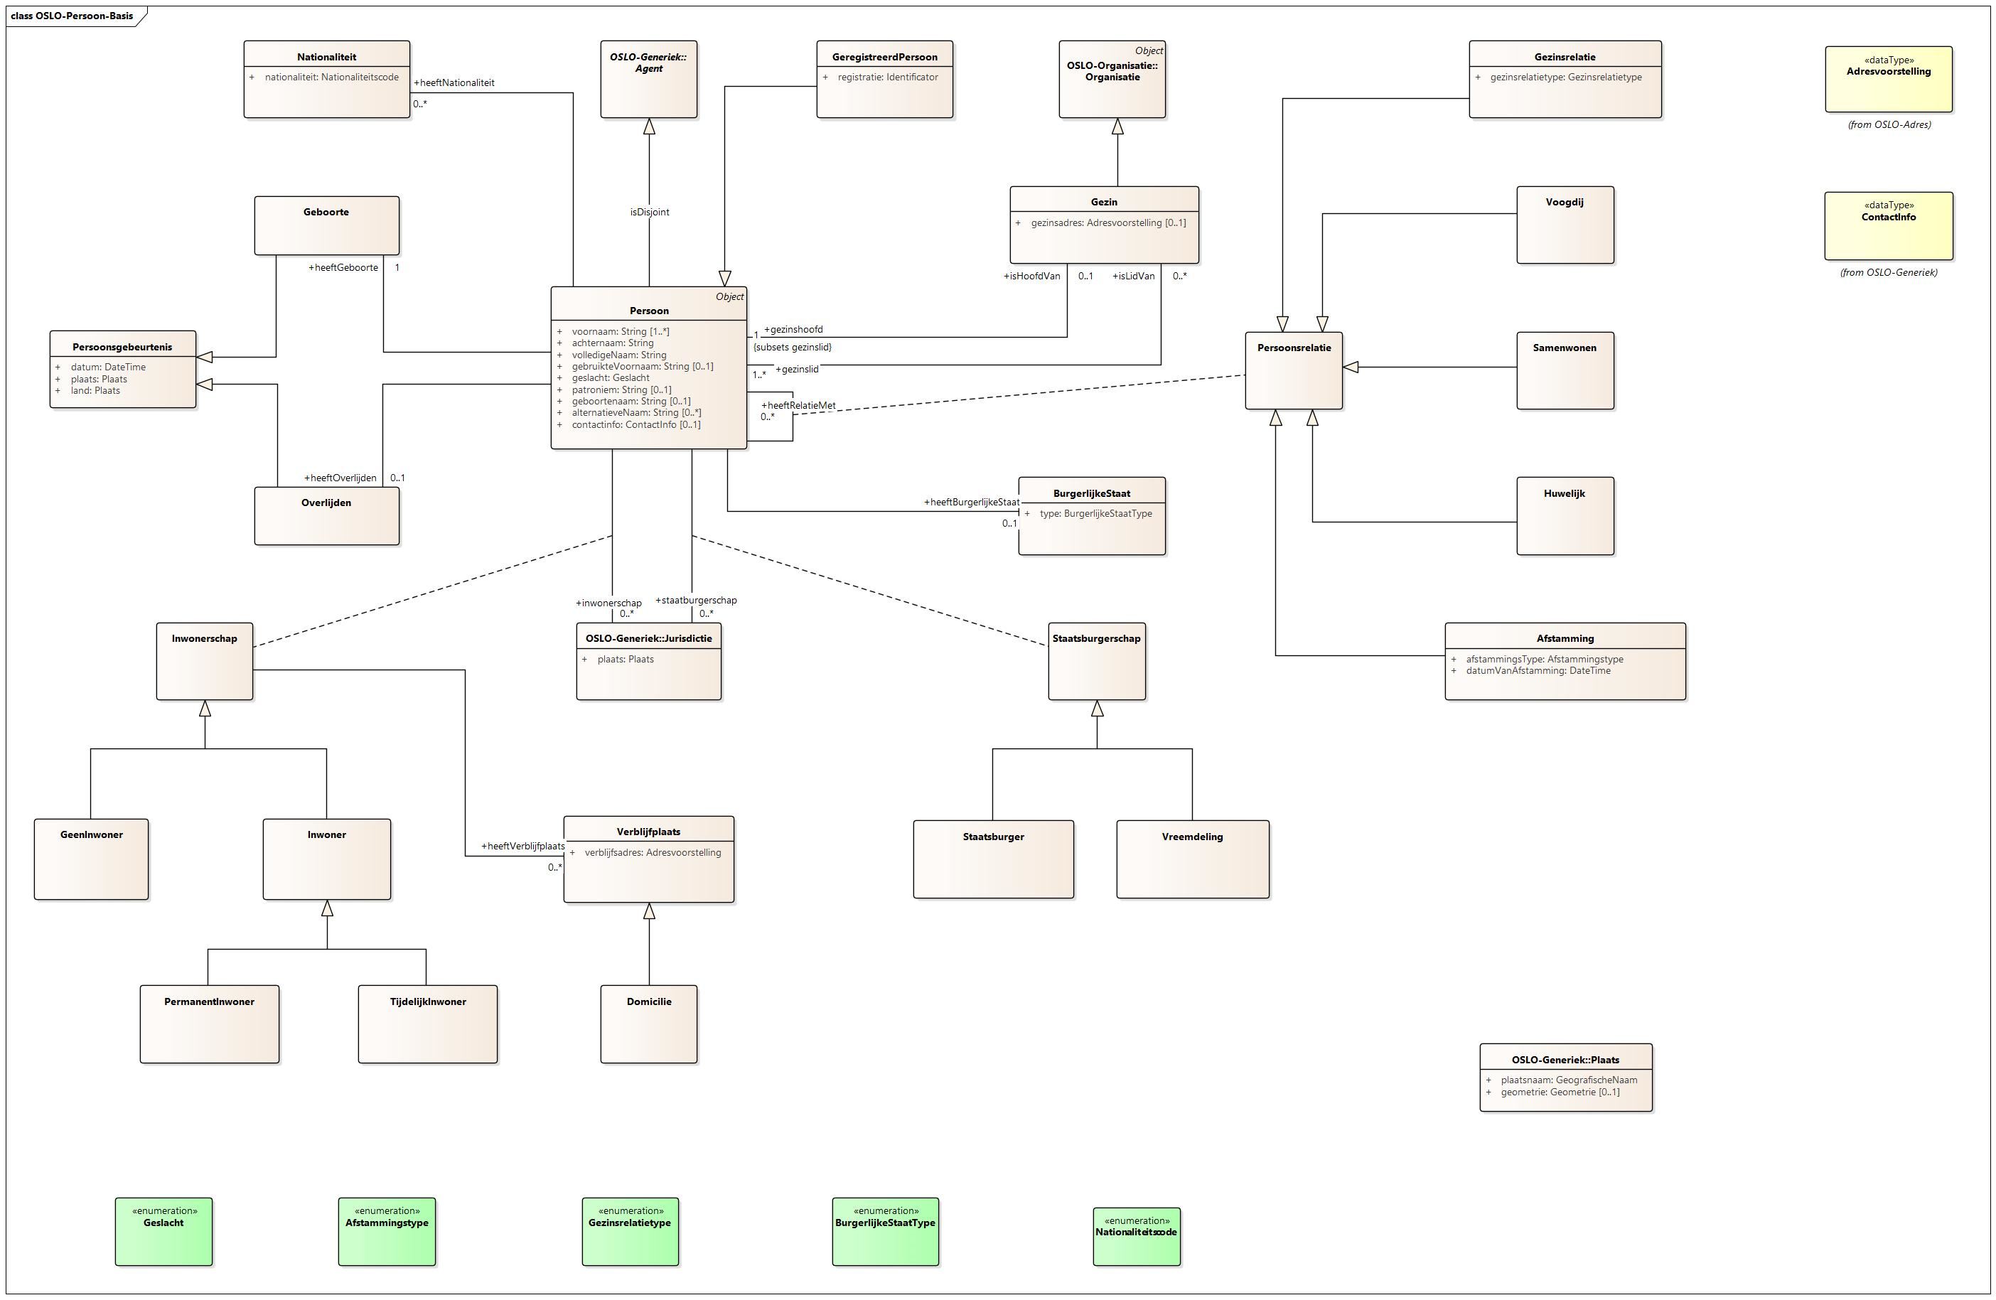
AmbassadeResident
Asielzoeker
BelgischResident
VoormaligResident
AdminstratieveStatus
Persoon.administratieveStatus (?)
Persoon.givenNames

